Slide 1
Pesticides

Slide 2
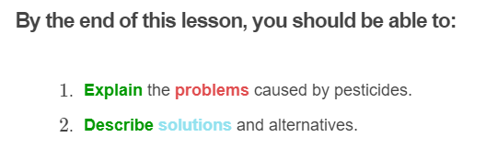
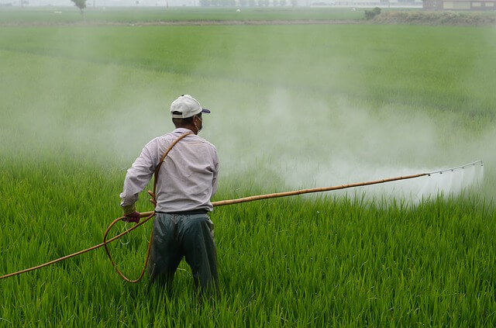

Slide 3
Pesticides are chemicals used to control pests around crops.
Insecticides kill animals which compete with humans for planted crops. Herbicides kill plants which compete with the planted crops.

Slide 4
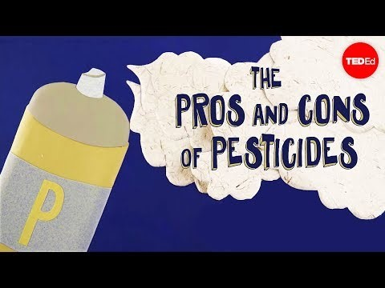

Slide 5
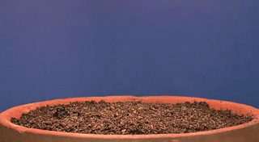
Pesticides can change the soil structure which will affect crops in the long term.
Some chemicals disrupt the cycle of nutrients. This means that important elements are no longer available for plants and organisms growth, making the soil less fertile.
In other words, crops will need more fertiliser and more chemicals will be used in the future.

Slide 6
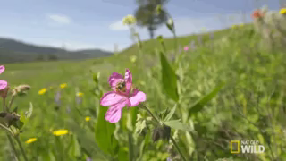
By killing non-target organisms, pesticides create unbalanced ecosystems.
Decomposers like earthworms are vital to maintain a good soil structure and return organic matter for plants growth. Pollinators (insects or birds) are needed for producers' reproduction.
Their populations decline due to the use of pesticides.

Slide 7
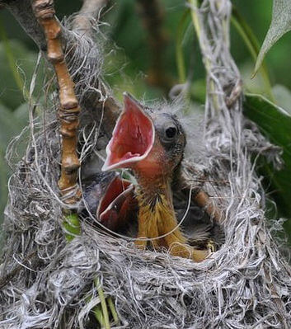
Pesticides cause problems way beyond the field where they are used.
Organisms like birds, amphibians and even fish are impacted!
Pesticides contaminate waterways and cause animal mortality worldwide, by damaging vital organs and functions.
This means that food webs are disrupted at various levels and the diversity in many ecosystems (or biodiversity) decreases.

Slide 8
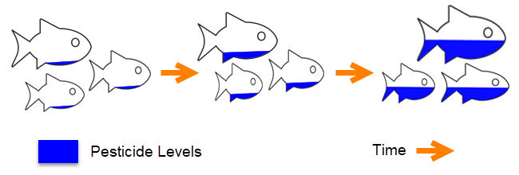
Non-biodegradable pesticides stay in the environment and contaminate the whole ecosystem.
Even small concentrations of pesticides are harmful because they bioaccumulate.
Bioaccumulation is the build up of a substance (such as a pesticide) in a living organism over time.

Slide 9
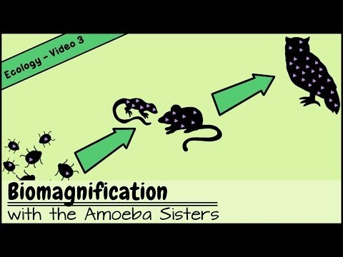

Slide 10
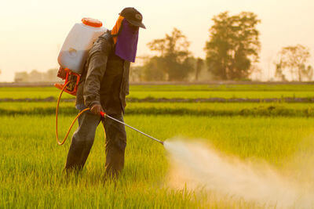
A small number of strategies for pesticide management exist.
Monitoring pest populations in a field before pesticide application is a good start, to evaluate how much is really needed.
Farmers should also restrict the number of applications over time and space, targeting the pest when it is at the most vulnerable stage of its life cycle.

Slide 11
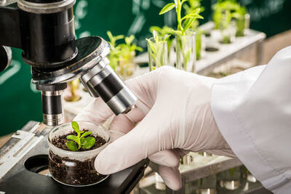
The development of biopesticides is an important research area for the future.
Those pesticides should control pests without harming non-target animals or leaving residues. They must be biodegradable to avoid all the problems created by usual pesticides.
While experts look for the next solution, governmental policies and laws are an important tool to reduce the entry of pests into a country and control their spread.

Slide 12
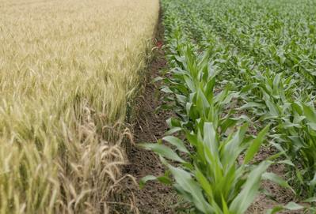
Alternative ways to grow crops can solve the problems created by pesticides.
Having a variety of crops, rather than a monoculture, can have an effect on pests. It can also result in a more efficient way of using resources like water and nutrients.
The use of barriers like net crop covers can stop insects from laying their eggs effectively without harming the ecosystem.

Slide 13
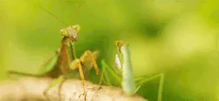
Beneficial insects can also reduce the impact of pests through predation or competition.
But remember that biological control can have unpredictable consequences!
Encouraging native insect populations is the best way to avoid more damage.

